Slide 1
Scrum breakfast June, 2017

Slide 2
Little warm-up game
Use the white sticky dots, please indicate your current role
If possible, can you write on the white dot your years of experience?
How different/same we are?

Slide 3



Themes
Open
Diversity
Enjoy

Slide 4
Agenda
Introduction
Story sharing

Slide 5
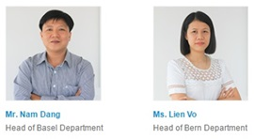
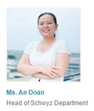
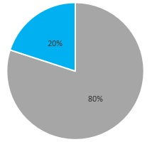
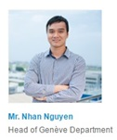
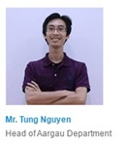

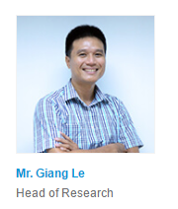
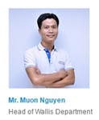

IoT team
Project:
Open source
Hardware
Software
Dev & Ops
Effort
Stake holders:
CEO
CIO
Directors
Notes:
Team name + members + locations
Effort
Projects
Stakeholder

Slide 6
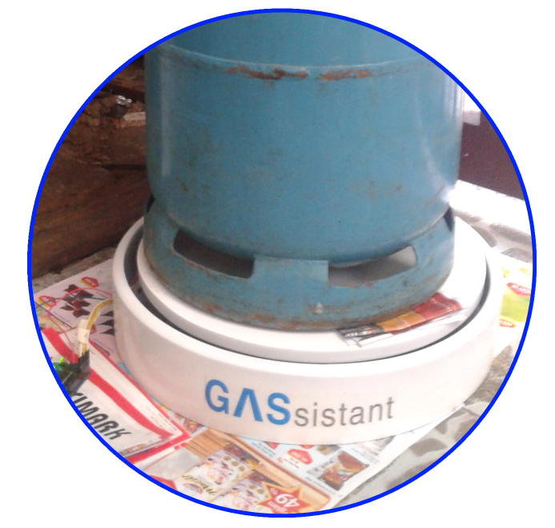
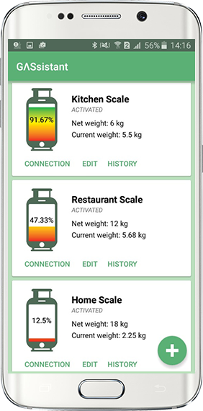
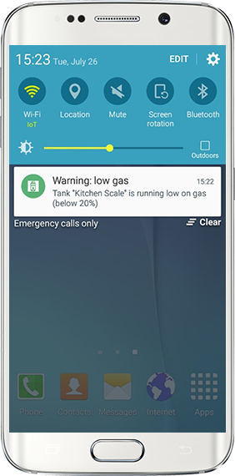
www.gassistant.org

Slide 7
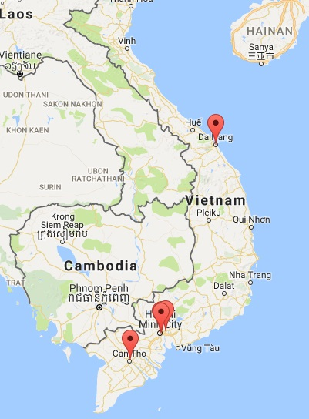
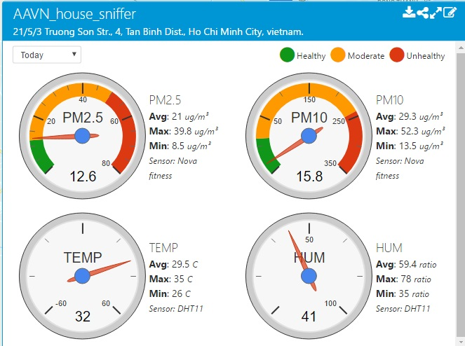
https://sniffer.axonactive.com

Slide 8
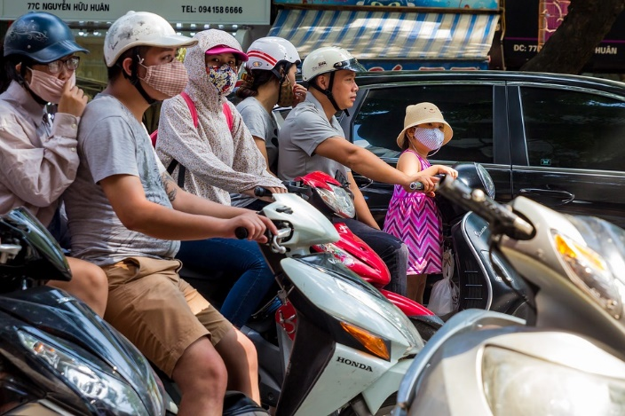
Masks is a must. Why?
Notes:
We wanna see beautiful faces on the street again

Slide 9
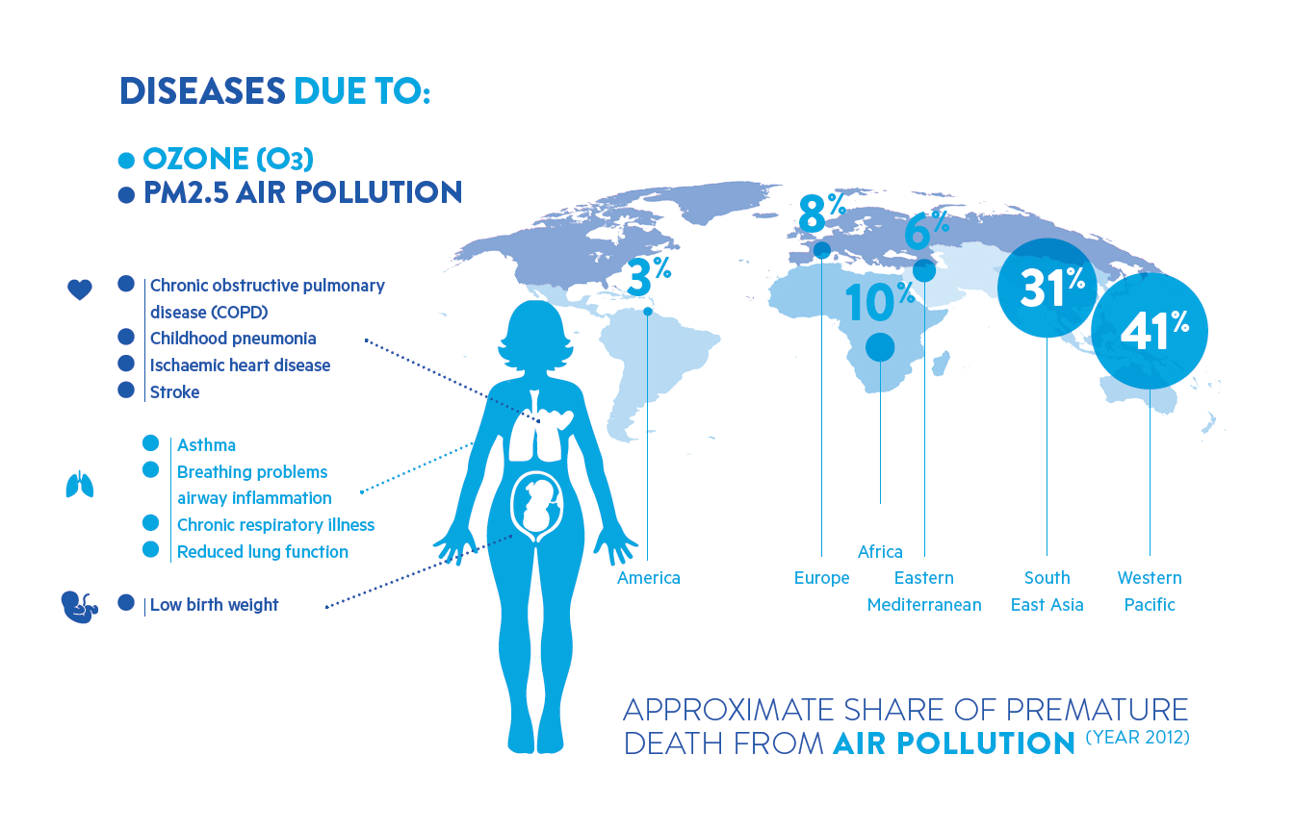

Slide 10
A self-running community
Distributed device network, publish data
Affordable, reliable, re-producible device
Notes:
GOALS
In a majority of the cases, when some people talking about a big plan to make positive change like this, we would imagine that they will work like crazy, scarify everything , contribute 200% of their effort to the goals, spend little time for family.

Slide 11

Notes:
Goal:
We wanna greatly take care other tasks/responsibilities
We wanna spend less time but get the best result

Slide 12

Failures
Practices

Slide 13

At the very beginning
We wanna apply Scrum!
Should we use Scrum?

Slide 14
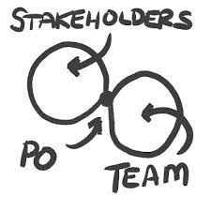
More than 1 POs?
Is it possible?
Or how can me make it possible?
Notes:
Those guys are not available to discuss the requirement
PO handle what stakeholders want, turn into product backlog items, prioritise them so that the team has something to do one by one

Slide 15
The Team is not co-located
Let’s form groups and make some discussion:
Which problems do you think the team has to face?
How would you suggest them to deal with it?
15 mins: discuss
3 mins/group: sharing

Slide 16



Slide 17
Rules
3 group, 2 persons/group
Follow the instruction
Do not let other groups know your goals
The group that finish first will win

Slide 18
Re-cap
Notes:
What happened at the beginning of the game?
How did you feel?
What did you think about other groups?
Audiences, what did you think? (in case the teams cannot figure it out)
Play another round and share goal

Slide 19

Notes:
The story when we want to separate into 2 team doing 2 projects.

Slide 20
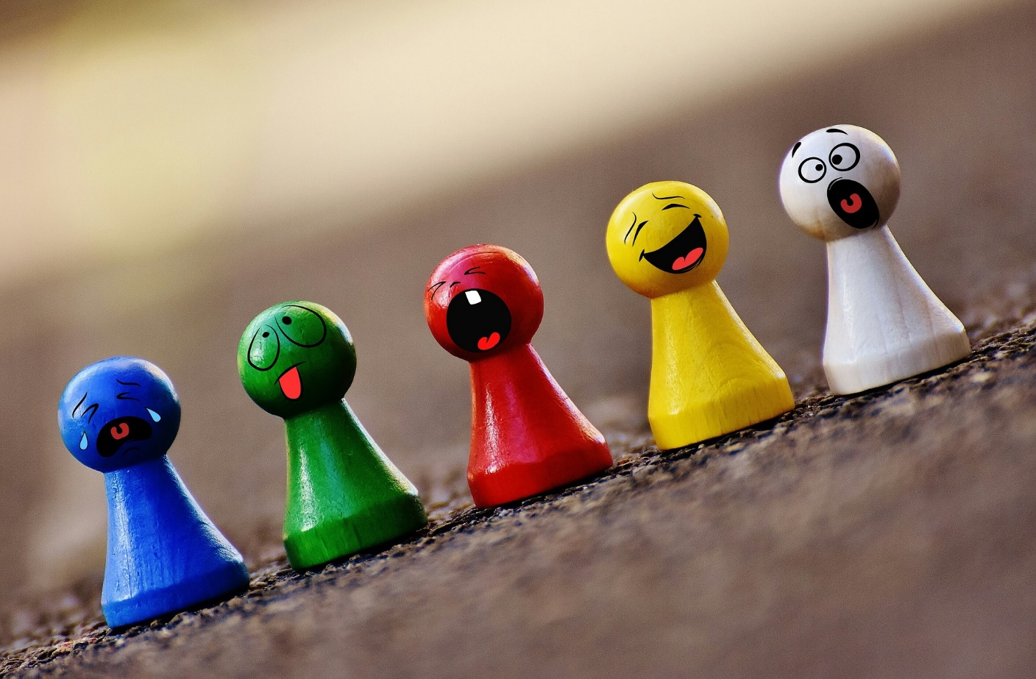
Communication. Direct Communication !
Notes:
When you have a distributed team like us, no matter what tools you are using for communication/synchronize data: skype, Slack, messenger …
Maximize the face to face communication is recommended.
Like us: we have 2 times re-union per year, we have daily with webcam
Share my story about other PO & teams feedbacks:
Christian story
Ask for team member’s feedback

Slide 21
Epics. Lots of Epics
We wanted to do many things at the same time (Eg: Energy issue, Make a huge & detail business plan, Make a perfect devices to measure many components)
We fail to prioritize those Epics
During the first 6 months, we made nearly no progress
Notes:
No thing was getting Done

Slide 22
Let’s get hand-on feeling about Epic
How would you make, install, maintain 1,000 Sniffers effectively?
Time: 15m preparation
Sharing: 5m/team
Notes:
Use Flipchart:
Make and install: 1000 → 200 Sniffer → 1 Sniffer/Sprint

Slide 23
The way thing is going right now
Lean startup
Team spirit
Remove barriers

Slide 24
Agreements
2 week cycle
Review, planning, retro, daily sharing
No estimation
Team board: www.myagile.org
SVN
Notes:
<1 thousand line of code

Slide 25

Team
Notes:
Team: diverse, stretch, brave, encourage, passion
Add team process and communication with other teams
Discussion question about team work, team spirit

Slide 26
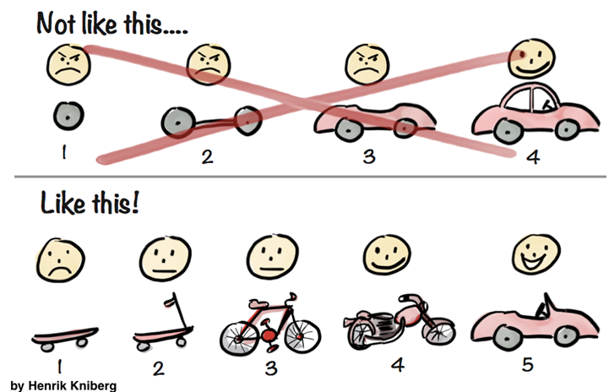
Incremental Shippable Product
The way things getting done
Notes:
The important of having not only a great team but also a great product
Mention incremental shippable product
Continuous delivery, remote upgrade?
(tesla concept about CD)
Cost reduction

Slide 27

Notes:
Talk about vision and next goals
Private/Public clubs
Trending/Social impact

Slide 28


Slide 29

Feedbacks
What you like?
What you do not like?
What you want to discuss next time?

